Slide 1
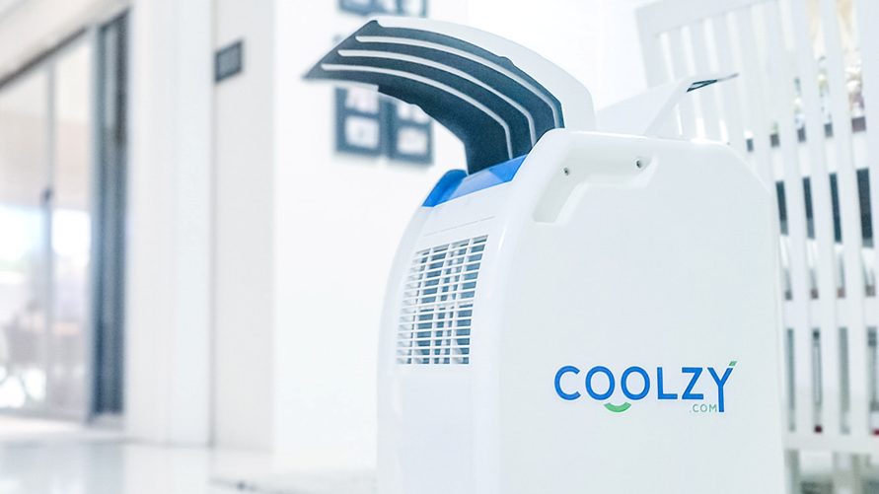
PRE-REVIEW DESIGN PRESENTATION
Owen Santoso (22466085)

Slide 2
Contribution to Date
Project lead for Week 2-3
Minutes taker for Week 4-5
Client liaison for Week 6-7
Lead in writing the risk register
Assisted in microcontroller choice of ESP32
State diagram verification of Coolzy unit

Slide 3

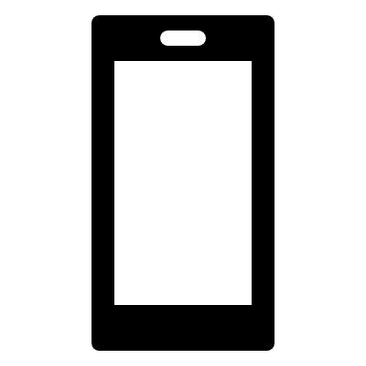
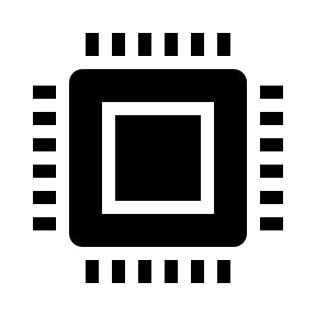


Requirements
The software design shall be simple enough for a competent person to understand.
The unit shall have the ability to connect and transmit user data to phones.
The microcontroller shall have the ability to store usage statistics on the unit itself.
The documentation shall include a state diagram of the functionality of the Coolzy.
The design budget shall not exceed $150 AUD.
Notes:
Through my preliminary research, I found that FPGAs are integrated circuits like microcontrollers, but they have higher processing power and are more flexible than their microcontroller counterparts. However, this comes at a much more expensive price point, and they are more difficult to program for.
Thus, FPGAs are typically used in applications which require complex logic and high processing power/speed. For designs which only need limited hardware and only need to perform specific set functions, microcontrollers are generally preferred especially due to their cost effectiveness.

Slide 4




Type of Controller: FPGA vs Microcontroller?
 | FPGA
Cost | More expensive
Programming | Comparatively complex
Portability | No portability across tools
Processing power | Higher
Microcontroller
Cheaper
Simple
Open source tools available
Lower
Require a controller for our new design
Discussed using FPGAs or microcontrollers
Decided to go with Microcontroller
Simple software
Usage statistics
$150 budget
Phone connectivity
State diagram
Notes:
Through my preliminary research, I found that FPGAs are integrated circuits like microcontrollers, but they have higher processing power and are more flexible than their microcontroller counterparts. However, this comes at a much more expensive price point, and they are more difficult to program for.
Thus, FPGAs are typically used in applications which require complex logic and high processing power/speed. For designs which only need limited hardware and only need to perform specific set functions, microcontrollers are generally preferred especially due to their cost effectiveness.

Slide 5
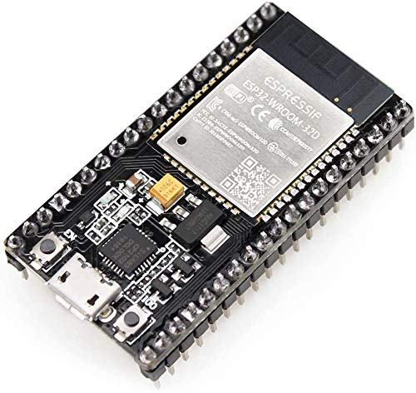
Microcontroller Choice: ESP32
Easy to program, able to use Arduino
In-built Bluetooth 4.2, BLE and Wi-Fi
Simplifies design, don’t need transmitter module
Reduces cost (~$2-3 USD)
4MB flash memory
Simple software
Usage statistics
$150 budget
Phone connectivity
State diagram
Notes:
Through my preliminary research, I found that FPGAs are integrated circuits like microcontrollers, but they have higher processing power and are more flexible than their microcontroller counterparts. However, this comes at a much more expensive price point, and they are more difficult to program for.
Thus, FPGAs are typically used in applications which require complex logic and high processing power/speed. For designs which only need limited hardware and only need to perform specific set functions, microcontrollers are generally preferred especially due to their cost effectiveness.

Slide 6
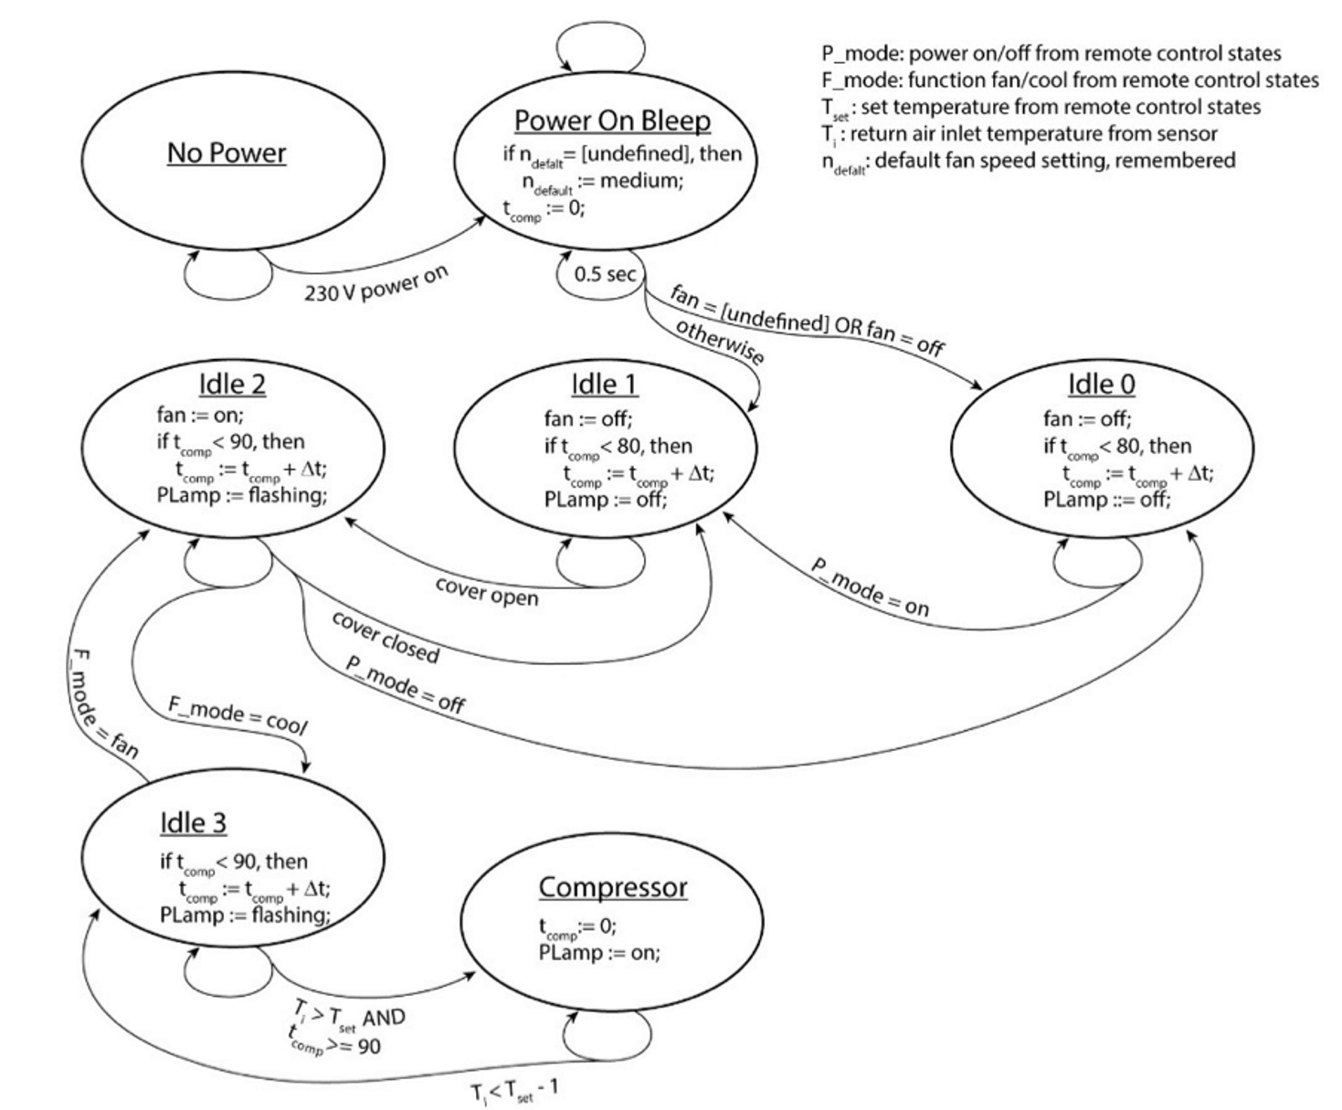


State Diagram Fixes
Missing states and transitions such as:
Excess water drawer removal
Turns off compressor after ~5 sec
Closing warm air deflector
Powers off machine
Sleep function for remote
Fan speed low
Increases temp by 0.5C after 30 mins
Increases temp by 2C after 2 hours
Simple software
Usage statistics
$150 budget
Phone connectivity
State diagram
Notes:
Through my preliminary research, I found that FPGAs are integrated circuits like microcontrollers, but they have higher processing power and are more flexible than their microcontroller counterparts. However, this comes at a much more expensive price point, and they are more difficult to program for.
Thus, FPGAs are typically used in applications which require complex logic and high processing power/speed. For designs which only need limited hardware and only need to perform specific set functions, microcontrollers are generally preferred especially due to their cost effectiveness.

Slide 7
Future work
Redrawing state diagrams to be complete
Software design logic flowchart
Coding ESP32 Arduino (if time permits)

